Slide 1
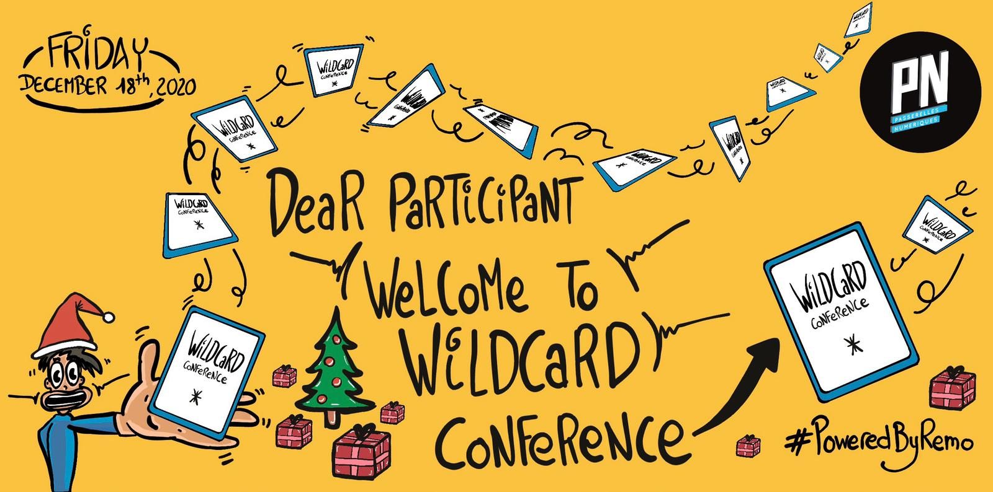

Slide 2
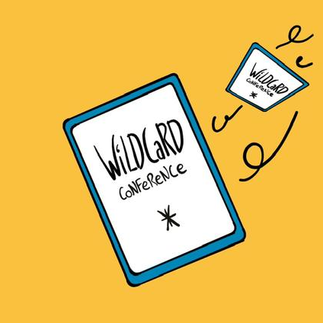

Architecture 2.0
Building for Sustainability
Adrien Nortain - WildCard Conference 2020

Slide 3
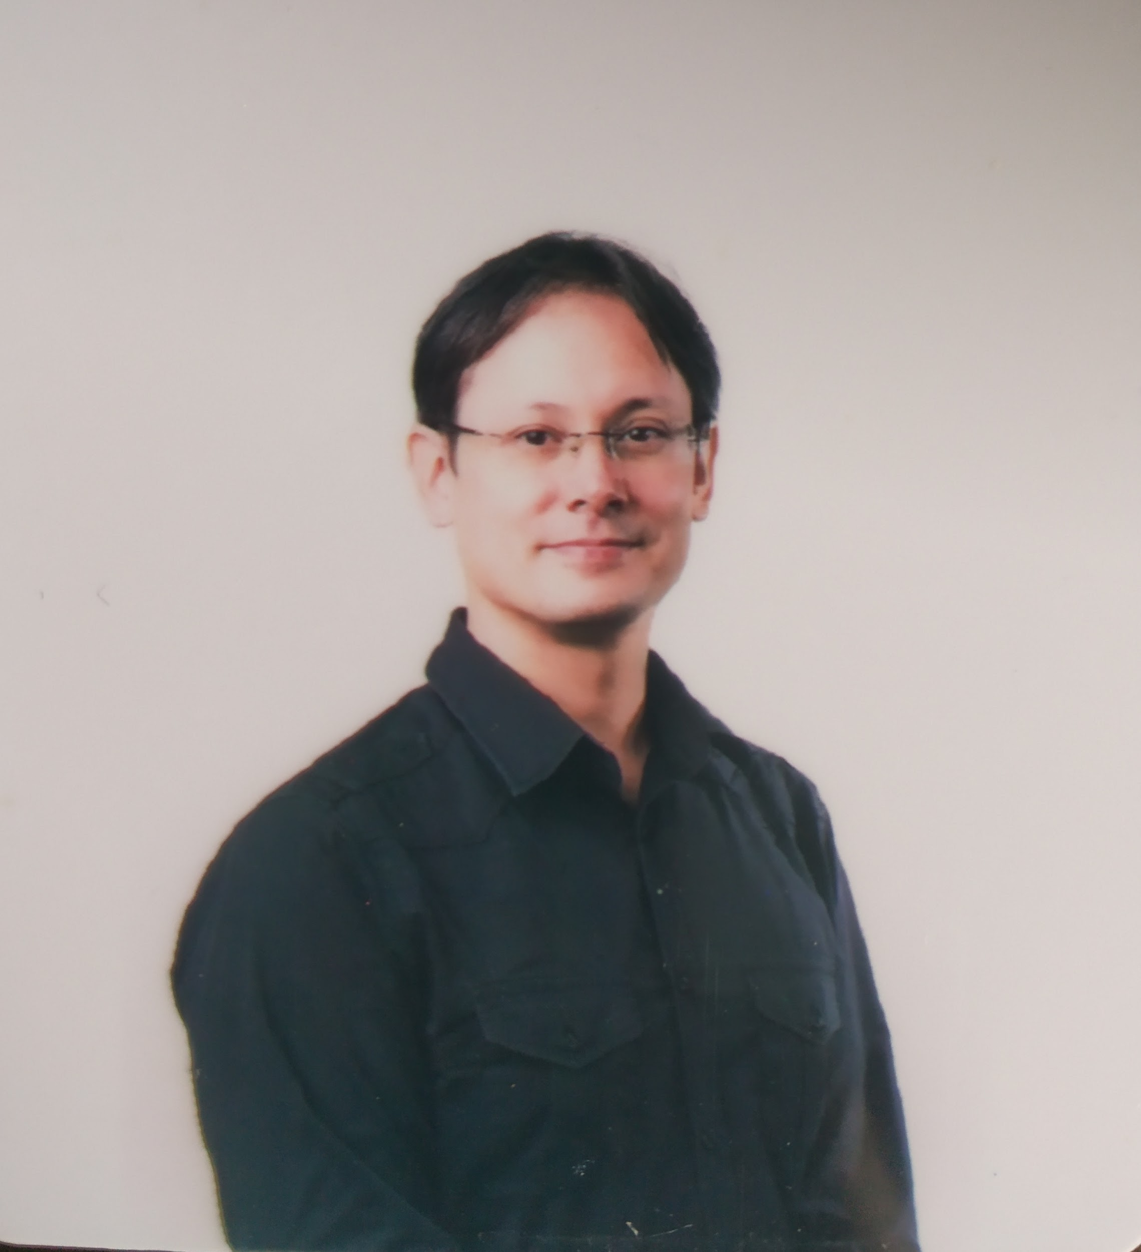
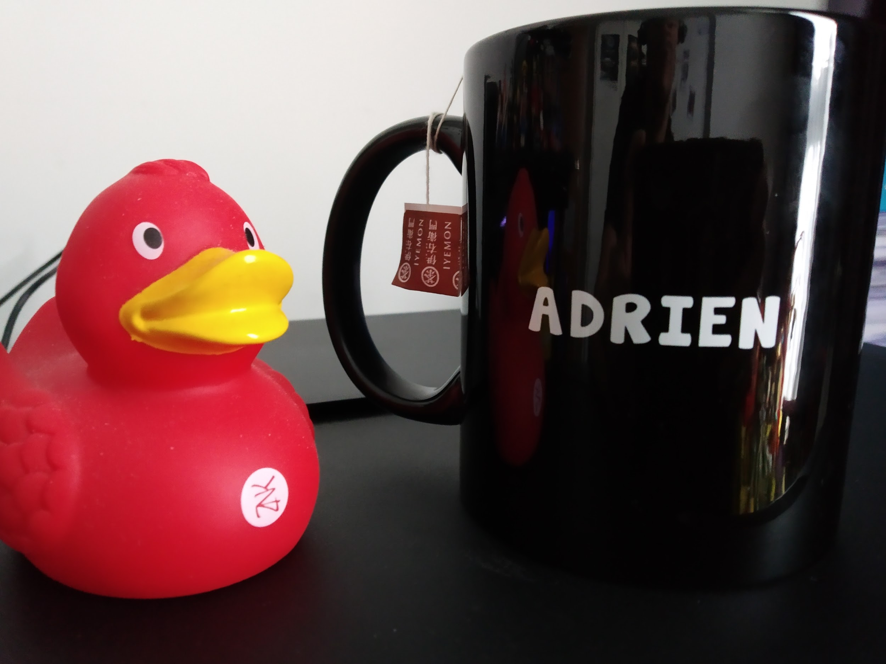
Quick bio
Adrien Nortain
Husband - Father
Agile Practitioner
IT-related topics Architecture Consultant
CTO at Zenika Singapore

Slide 4
Architecture VS Engineering?
Architect means “Lead Builder”
(Greek)
Strategic
Vision-focused
It overlaps.
It is mainly about FOCUS.
Engineer means “Creator”
(Latin)
Tactical
Solution-focused

Slide 5
What do we expect from architects?
Options for alignment
Vision
Business
Operations
IT Standards
IT Resources
IT Talents
Notes:
Gregor Hohpe: “Architects sell options”

Slide 6
Career path? School of architecture?
The “Swiss Army Knife”
Decision Making
Engineering
Methodologies
Consulting
Facilitation
Leadership

Slide 7
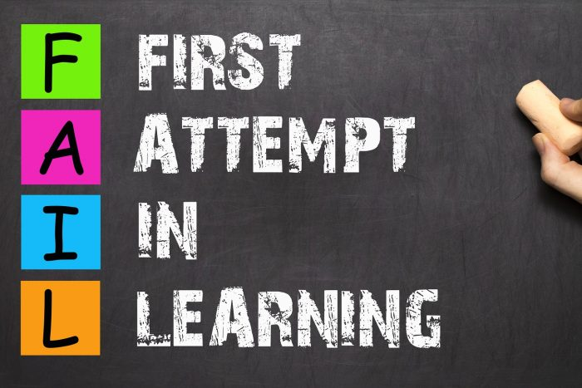

“Failure-Driven Architecture”
School
from scrum.org
Notes:
https://www.cio.com/article/3211485/why-it-projects-still-fail.html

Slide 8
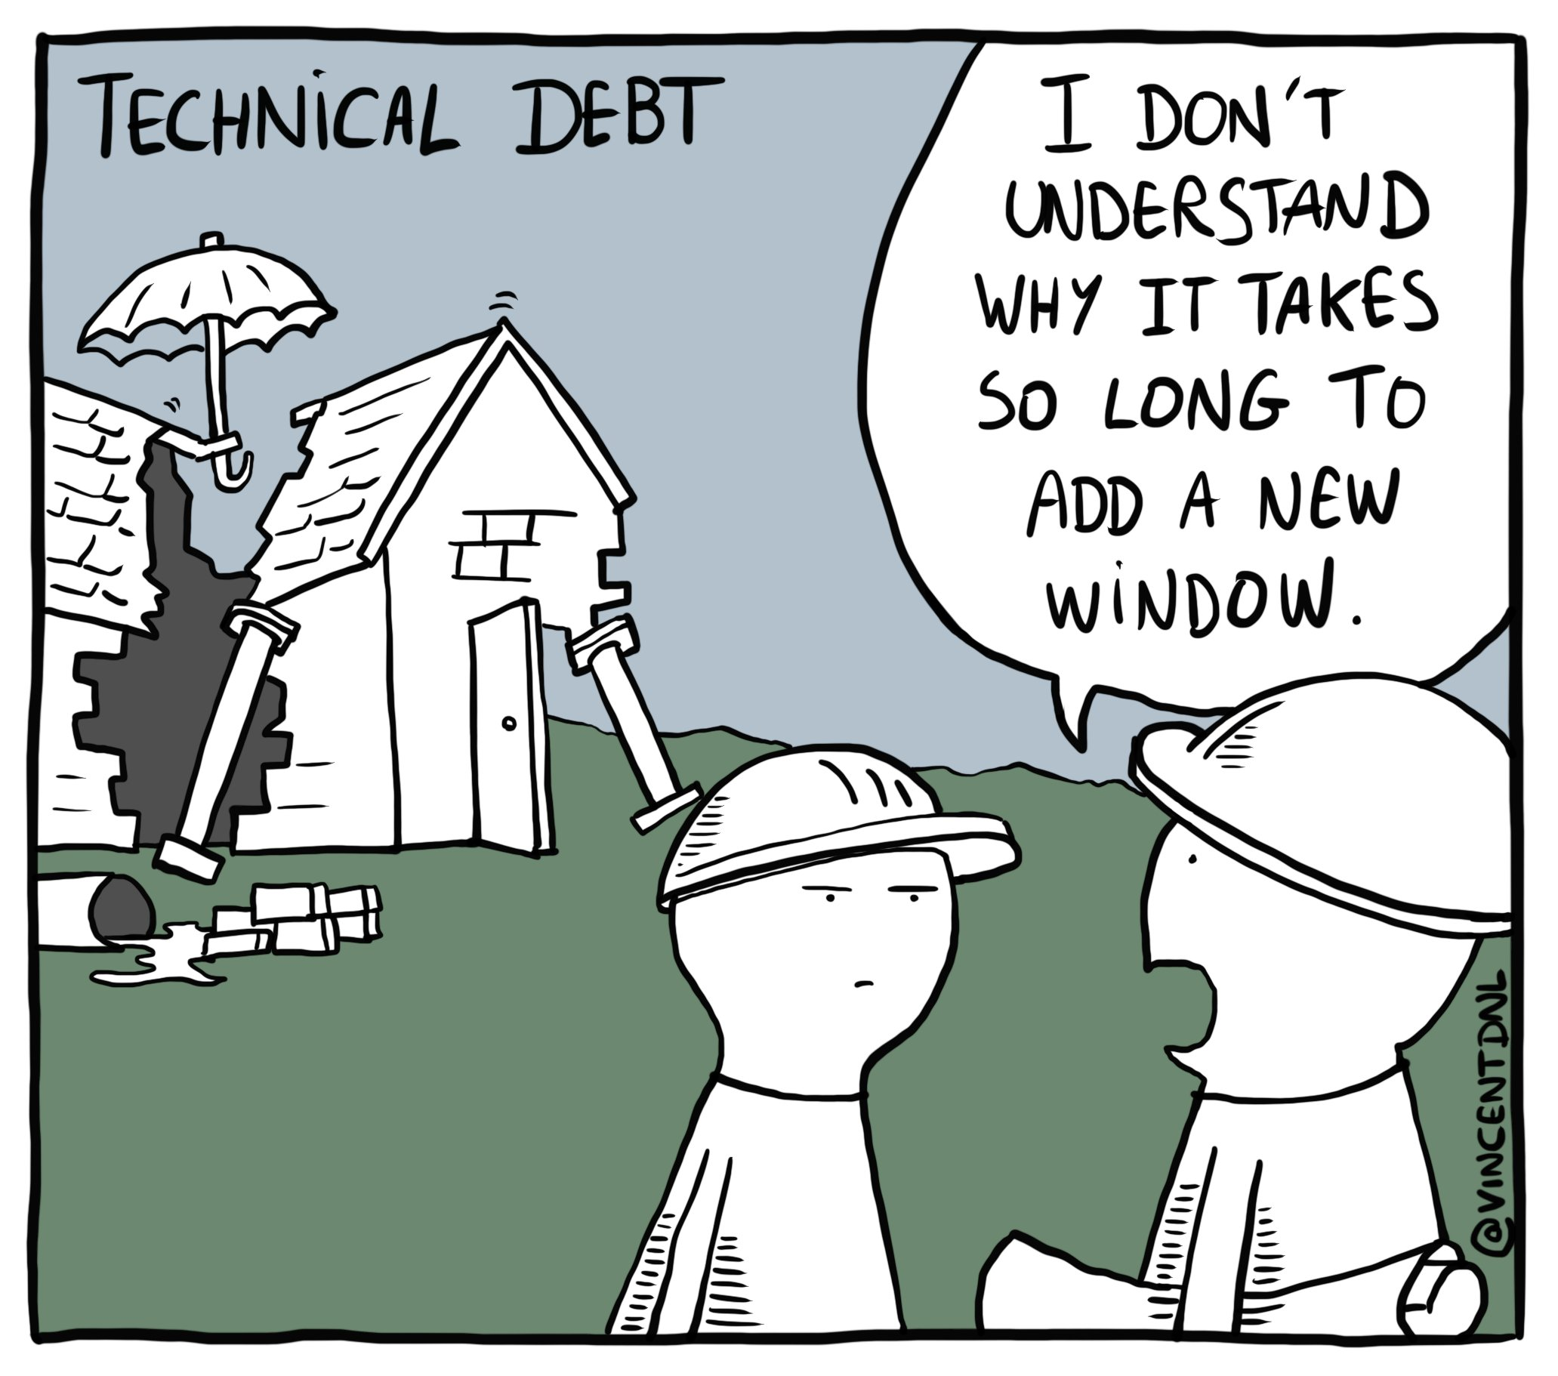
Failures from Tech Debt and Conway’s Law
This is not an architect btw

Slide 9
Failures from biases and marketed recipes
“We’ll move to a Microservice Architecture to make our application more maintainable”
With a team of 5 devs and no DDD
“It’s because Business can’t make up their mind that our deliveries are mediocre”
An Agile Dev team
“We are going to save money and time putting our whole infrastructure in the Cloud”
A national business run by traditional SysAdmins
Famous last words.

Slide 10
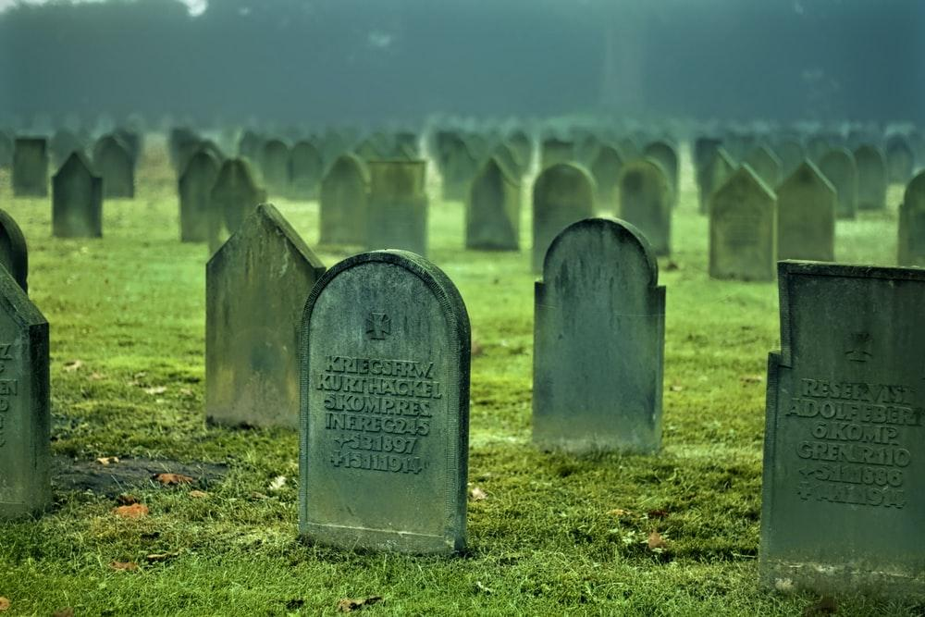
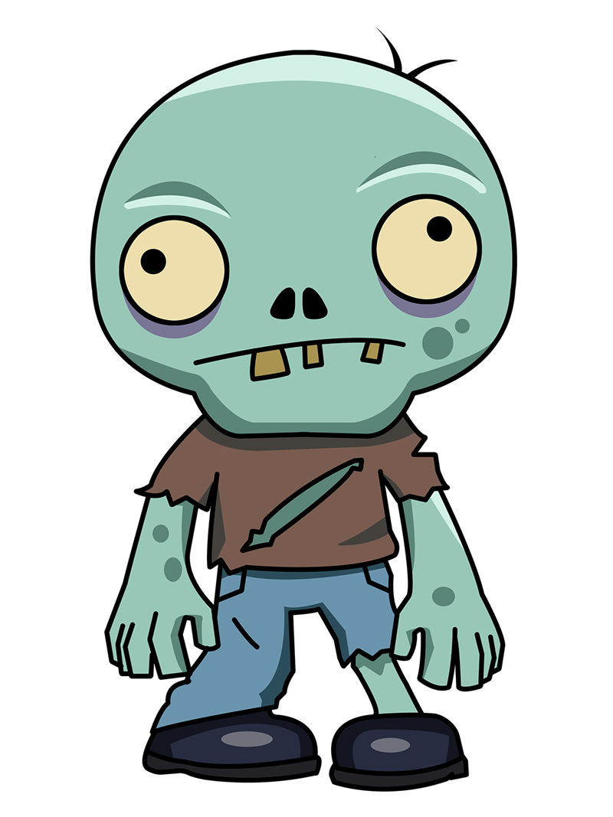
Failures from obsolescence / deprecation
They used to be “modern” techs...
COBOL
See you Flex
RIP Struts
Here lies WESB
I <3
WAS 6.1
In memory of Objective-C
Notes:
Framework is a promise that is never kept.

Slide 11
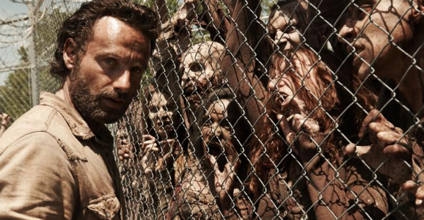
Maintaining legacy systems (allegory)
Maybe I should stop creating zombies...

Slide 12

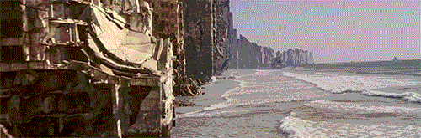
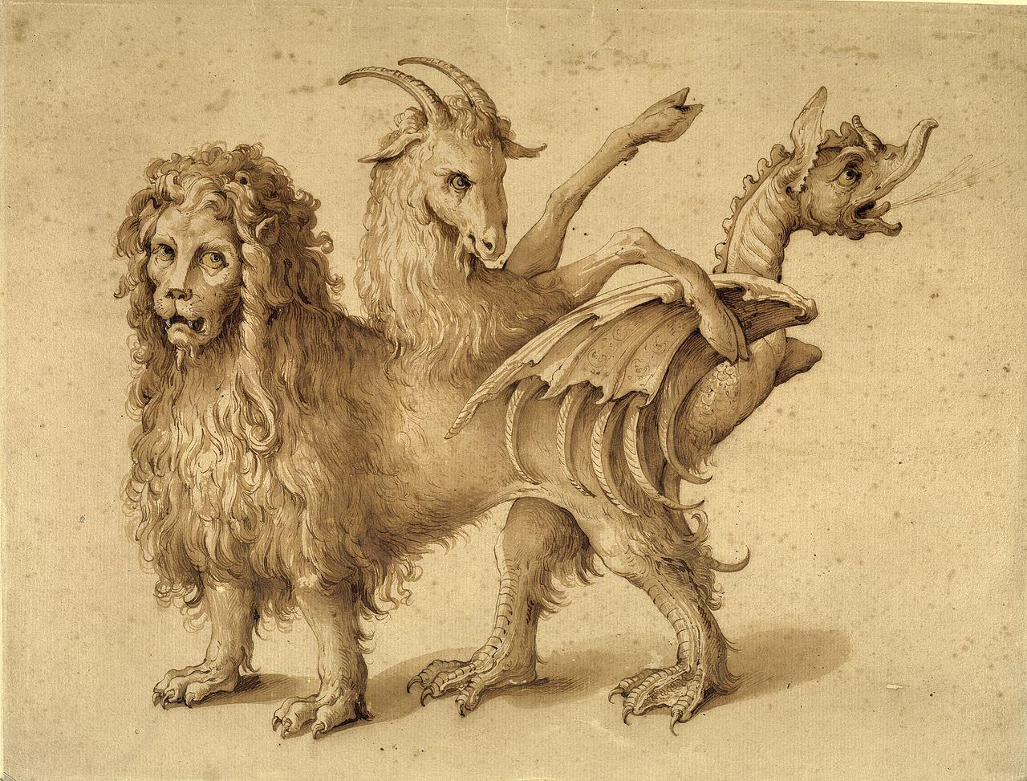
The failures of traditional architecture
Cognitive overload alert!
Overrun by COMPLEXITY!
Legacy
Business
Workflow
UX / UI
...
3rd party
Data Access
Data Processing
Data Flow
...
Integration
Stuffs
Monitoring
Workload Distribution
Networking
...
Notes:
He who fights with monsters might take care lest he thereby become a monster. And if you gaze for long into an abyss, the abyss gazes also into you. - Nietzsche
Even if complexity is relative, not any engineer is capable of memorizing such systems.
Things don’t get simpler: Dave Thomas: “Simplicity - The Road Not Taken”

Slide 13

Breathe.

Slide 14
Architect retreat: Sustainability
People
Equitable
Liveable
Sustainable
Profit
Planet
Viable

Slide 15
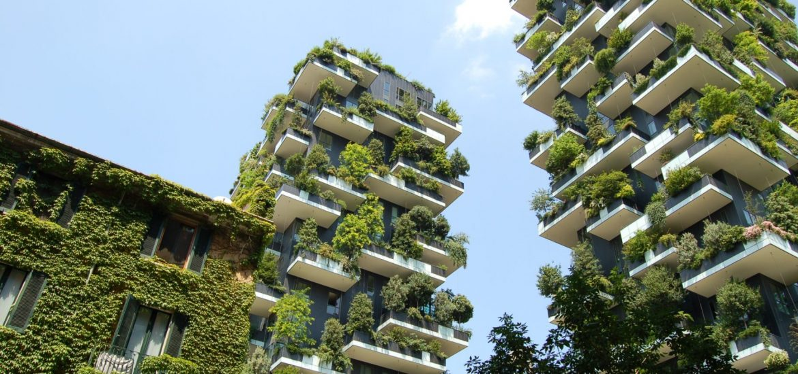
Ideas for Architecture 2.0? Let’s explore!

Slide 16
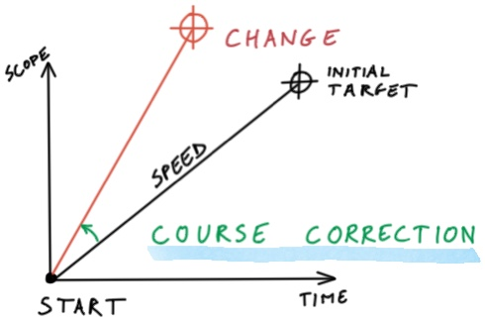
Learnings from Agile
Don’t think “target”.
Think ”change”.

Slide 17
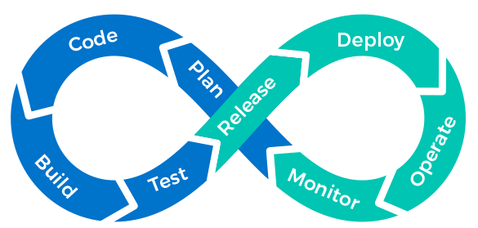
Learnings from DevOps
Architect the
Continuous Deployment foundations
Don’t think “punctual”.
Think ”continuous”.

Slide 18

Learnings from Low-tech
Does it need digitalization?
Do we contribute to hardware recycling?
Are we inclusive?
Is Cloud helping?
Controlling growth.
Controlling hardware usage.

Slide 19

Learnings from other fields
Sustainable gardening principles!
Do no harm
Use the Precautionary principle
Design with nature and culture
Use a decision-making hierarchy of preservation, conservation, and regeneration
Provide regenerative systems as intergenerational equity
Support a living process
Use a system thinking approach
Use a collaborative and ethical approach
Maintain integrity in leadership and research
Foster environmental stewardship

Slide 20
Agile Architecture as a solution?
Multiple different definitions (SAFe, TOGAF…)
Continuously Align
Document
Design
Vision
Intent
Roadmap
Intentional
Emergent
Reversible
Product
Organization
Operations
Notes:
https://www.scaledagileframework.com/agile-architecture
https://pubs.opengroup.org/architecture/o-aa-standard/
Gregor Hohpe: True Architecture is Agile

Slide 21
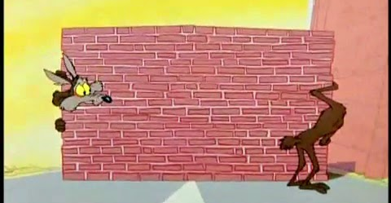
Is the outcome really different?
It is “truer” or better defined architecture.
It is still highly complex / complicated.
Eventually hitting a wall - with a different angle.

Slide 22

So what must we focus on to stop monsters?
Change Rate
Continuous Deployment
Design Collaboration
Teams Preservation
Hardware Lifecycle Awareness
Regenerative Systems
Social Responsibility
Ethical Leadership

Slide 23
Breathe.
And remember your training.

Slide 24
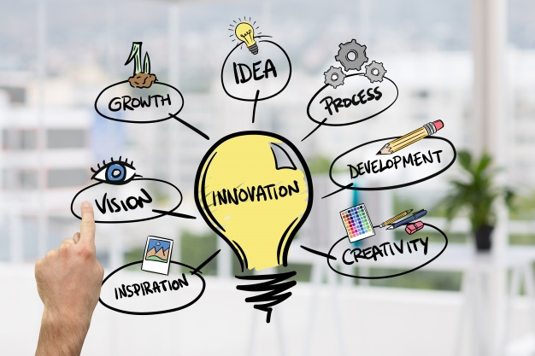
You know Change
Mindset
Innovation to keep ahead of things
Find your own rhythm
Be positive and fearless
Play and enjoy the journey
Wood photo created by creativeart - www.freepik.com

Slide 25
You know Continuous Delivery
Footwork
End-to-End Agility as a strong foundation
Reversibility in mind
Reduced impact of failures
Probe and learn

Slide 26

You know Decision-Making
Strategy
Narrowing down the options
BALANCED Decisions
Collaborative
Architecture Decision Records
Focusing on INTENT
Comparing different OPTIONS

Slide 27

But you may have forgotten something
These are only “techniques”.
You need “drivers”.
Notes:
Technique is about the how, it’s pure activity
Driver brings purpose

Slide 28
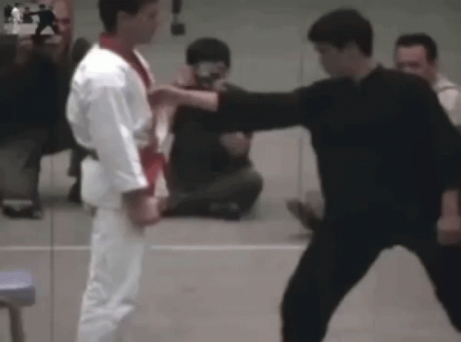
You move towards Simplicity
Strength
Seeking precision and impact
Be Runtime or Hardware-focused
Keep It Sustainably Simple
from Green Advocate Margerie Guillot
YAGNI for 3 Ps
KISS

Slide 29
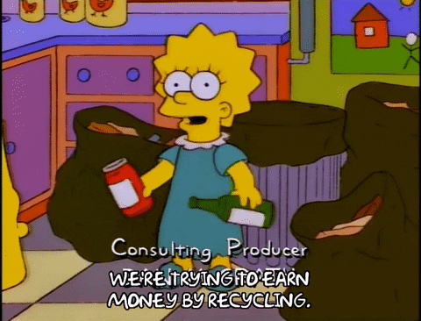
You move while Regenerating
Stamina
Seeking resilience to time and efforts
Secondary: Optimize
Primary:
Reuse
Tertiary:
Innovate
Notes:
3 types of recycling:
Primary - Do the exact same thing with your recycled elements
Secondary - Build something of similar form and constitution
Tertiary - The chemist: transform it

Slide 30
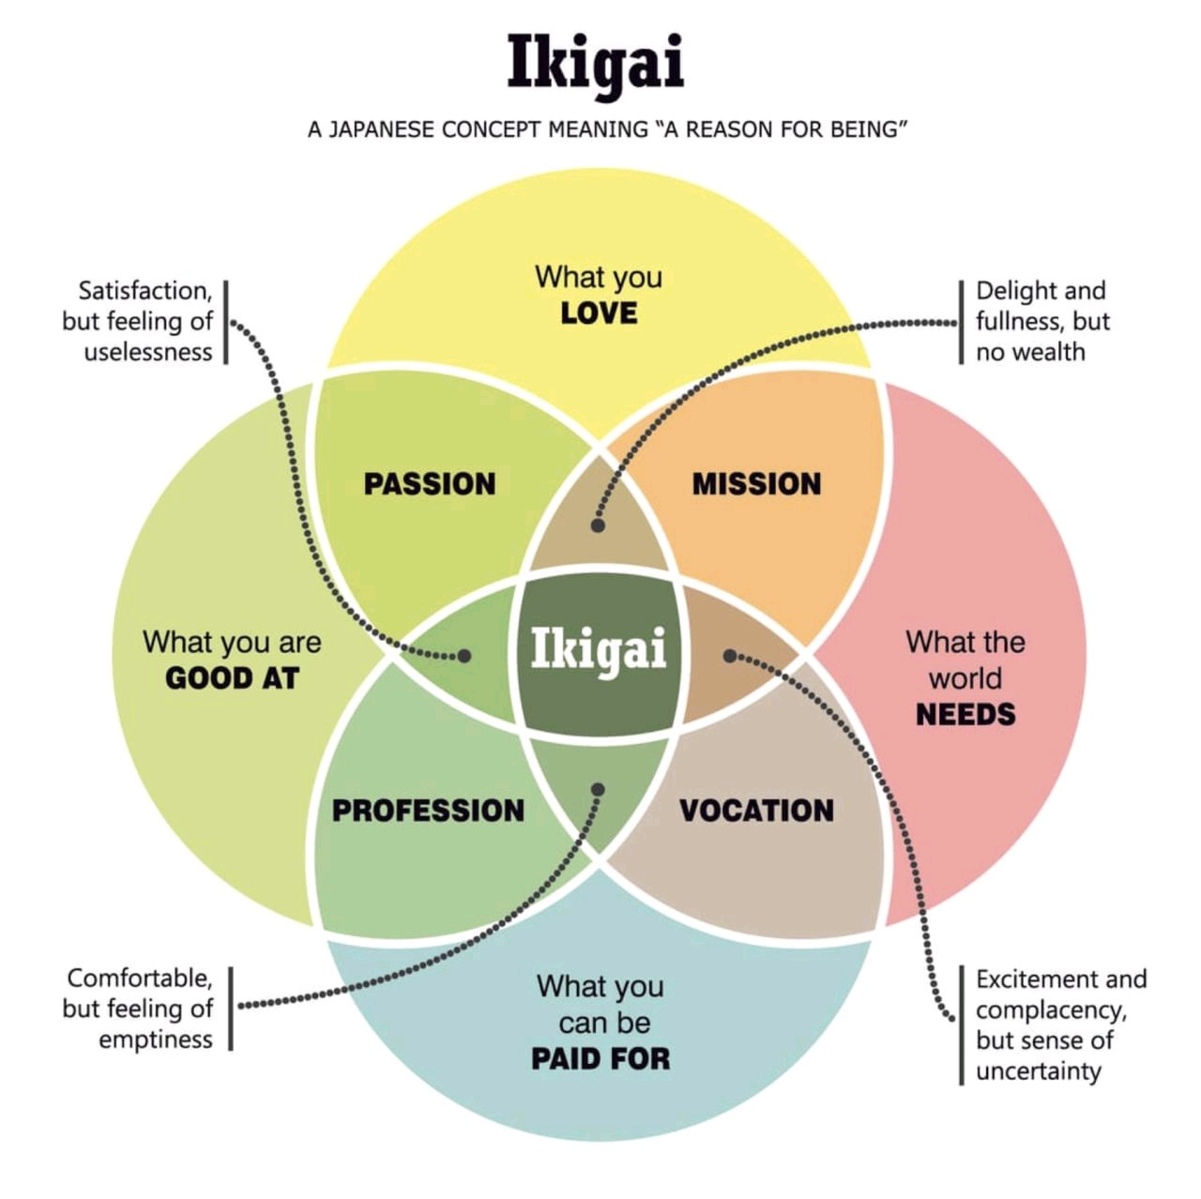
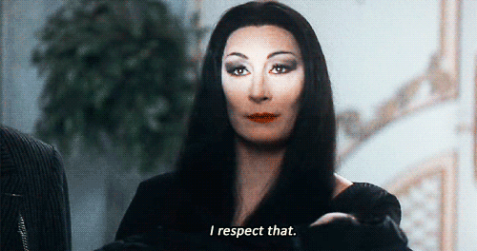
You move from Core Values
Heart
Seeking meaning with humility

Slide 31

Do you still fear monsters?
There is no right and wrong anymore.
There is an intention, a clear objective and the right tools.
It’s time to simplify things and save monsters from themselves.
Notes:
There is no Monolith VS Microservices
Do not pit architecture targets against each other
Solve your issues, not the others

Slide 32
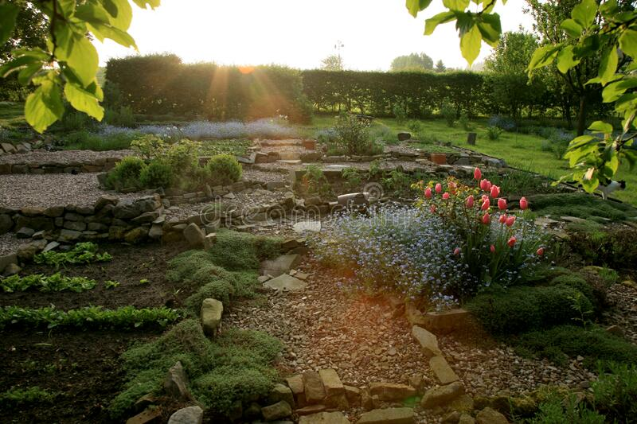
Peace in Balance and Simplicity
Balancing the 3Ps maintains:
Simplicity
Regeneration
Core Values
This can foster sustainable:
Innovation
Continuousness
Decisions

Slide 33
From Practitioner to Teacher
Prove that your approach works!
Guide engineers on how to be future-driven
Simplicity: Do we understand the target?
Regeneration: What do we transform?
Core Values: Is our goal aligned with what we are?
Change: How do we keep improving?
Continuous Delivery: Can we produce efficiently?
Decision-Making: Is everybody aligned?

Slide 34
Towards a driven architect role?
The “Sustainable Builder”
Fearless
Change©
Continuous
Deployment
Collaborative Design
Engineering
Advising
on Simplicity
Facilitating
Regeneration
Leading
with Core Values
Notes:
Engineering is included in all phases! Don’t forget to be an engineer once in a while…

Slide 35
Going Beyond
Art - Music, Storytelling, Martial Arts…
Nature - Forests ecosystems, Permaculture...
Philosophy - Beyond Good and Evil Architecture?
Science - Neuroscience, Economics...
“The snake which cannot cast its skin has to die. As well the minds which are prevented from changing their opinions; they cease to be mind.”
The Dawn of Day, Friedrich Nietzsche
Notes:
Linda Rising,
Jessica Kerr,
Dave Thomas...

Slide 36
THANK YOU!
WildCard Conference 2020

